Slide 1
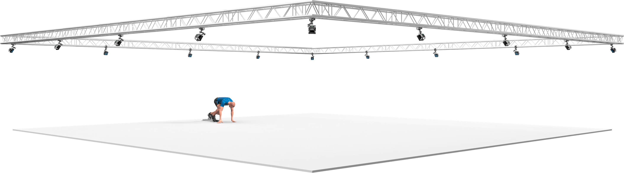
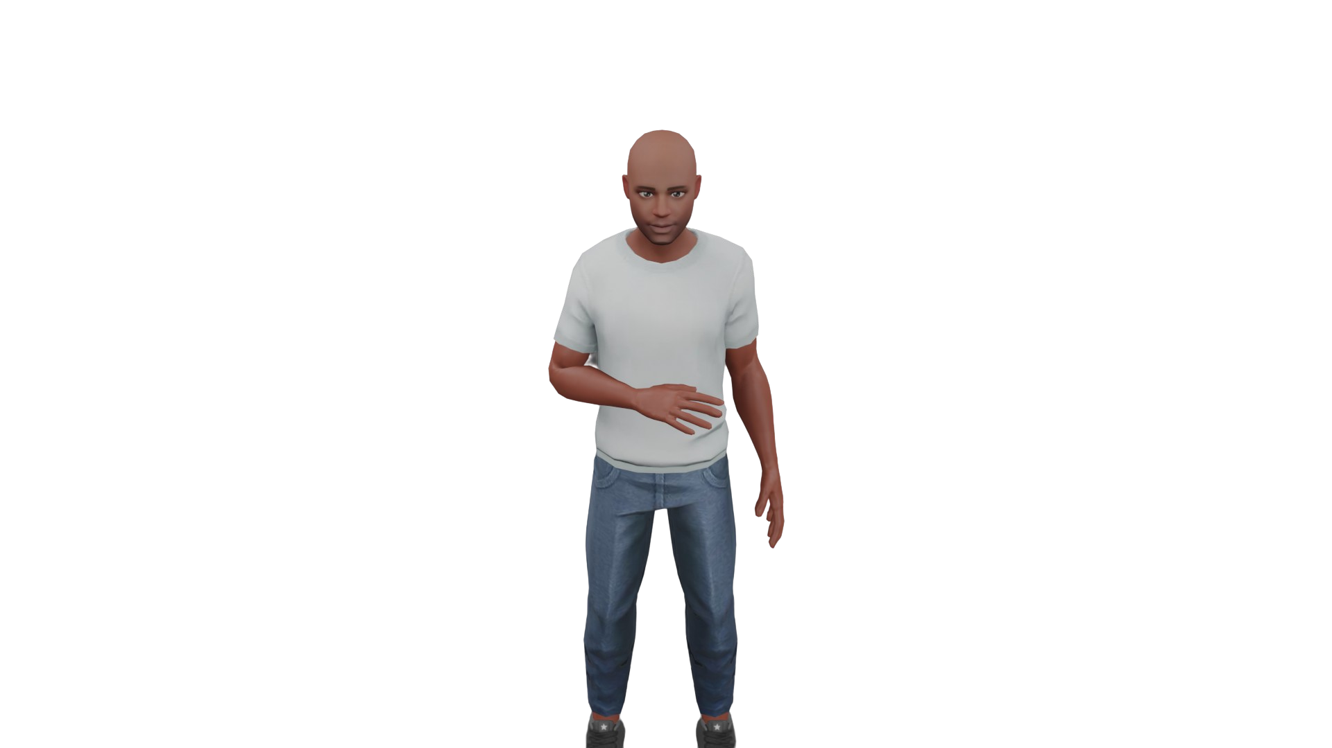

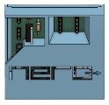

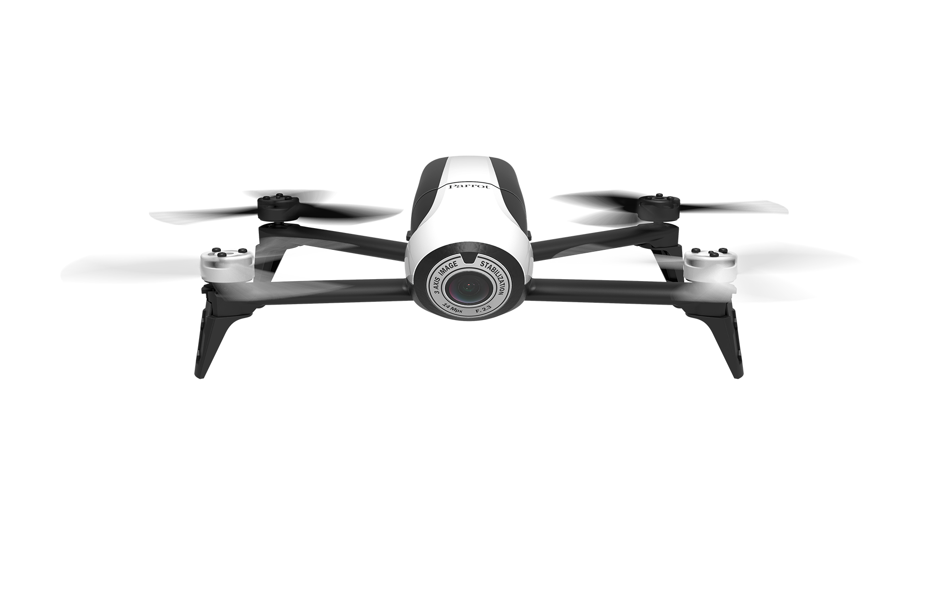

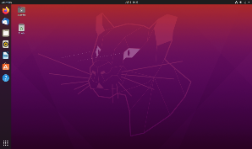




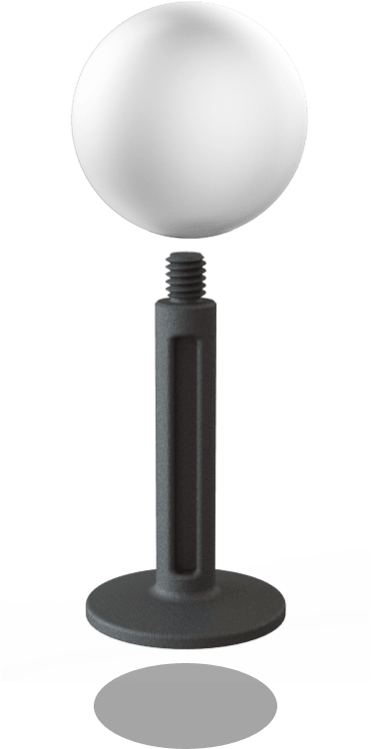


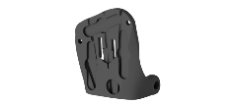
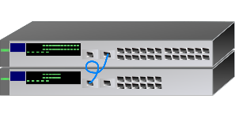



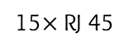
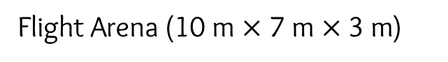
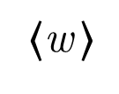
15$×$ OptiTrack
Cameras
Mocap Markers Detection
...
Onboard PCB
Light source
Windows
Desktop PC
Ubuntu PC
ROS Master/Nodes
Ethernet Switch
Bebop 2
Parrot Inc.
RJ 45
RJ 45
15$×$ RJ 45
...
RJ 45
Mocap Markers
Joystick
(emergency command)
$〈$w $⟩$
Flight Arena (10 m $×$ 7 m $×$3 m)

Slide 2
15$×$ OptiTrack
Cameras
Mocap Markers Detection
...
Onboard PCB
Light source
Windows
Desktop PC
Ubuntu PC
ROS Master/Nodes
Ethernet Switch
Bebop 2
Parrot Inc.
RJ 45
RJ 45
15$×$ RJ 45
...
RJ 45
Mocap Markers
Joystick
(emergency command)
$〈$w $⟩$
Flight Arena (10 m $×$ 7 m $×$3 m)

Slide 3
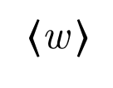
d_{min} = 2.5 m
$〈$w $⟩$

Slide 4
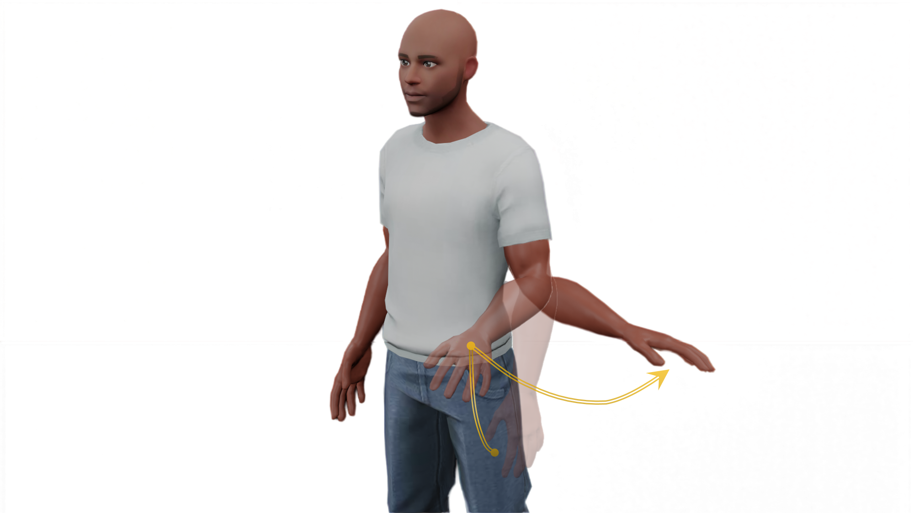
Gesto 1:

Slide 5
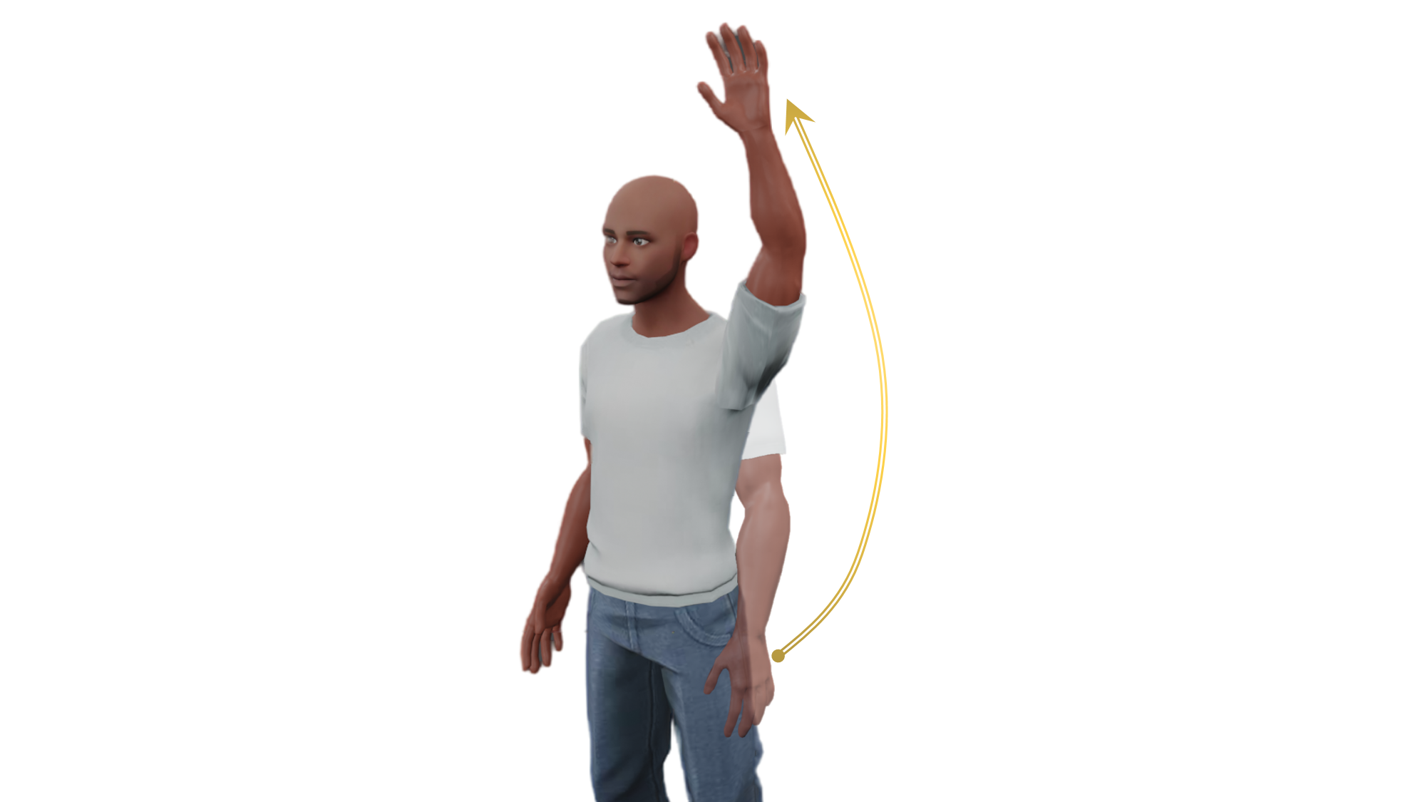
Gesto 2:

Slide 6

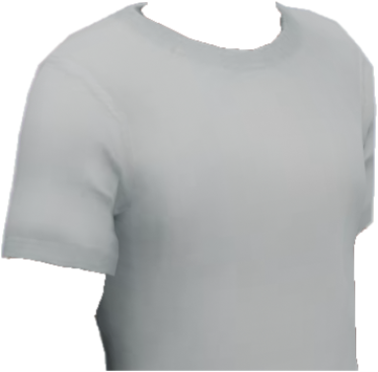
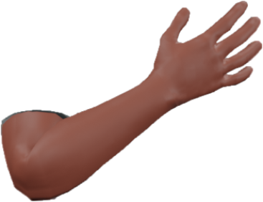
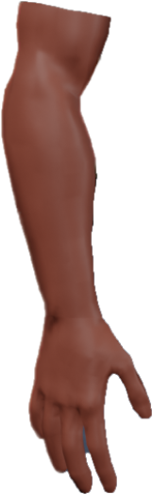
Gesto 3:

Slide 7
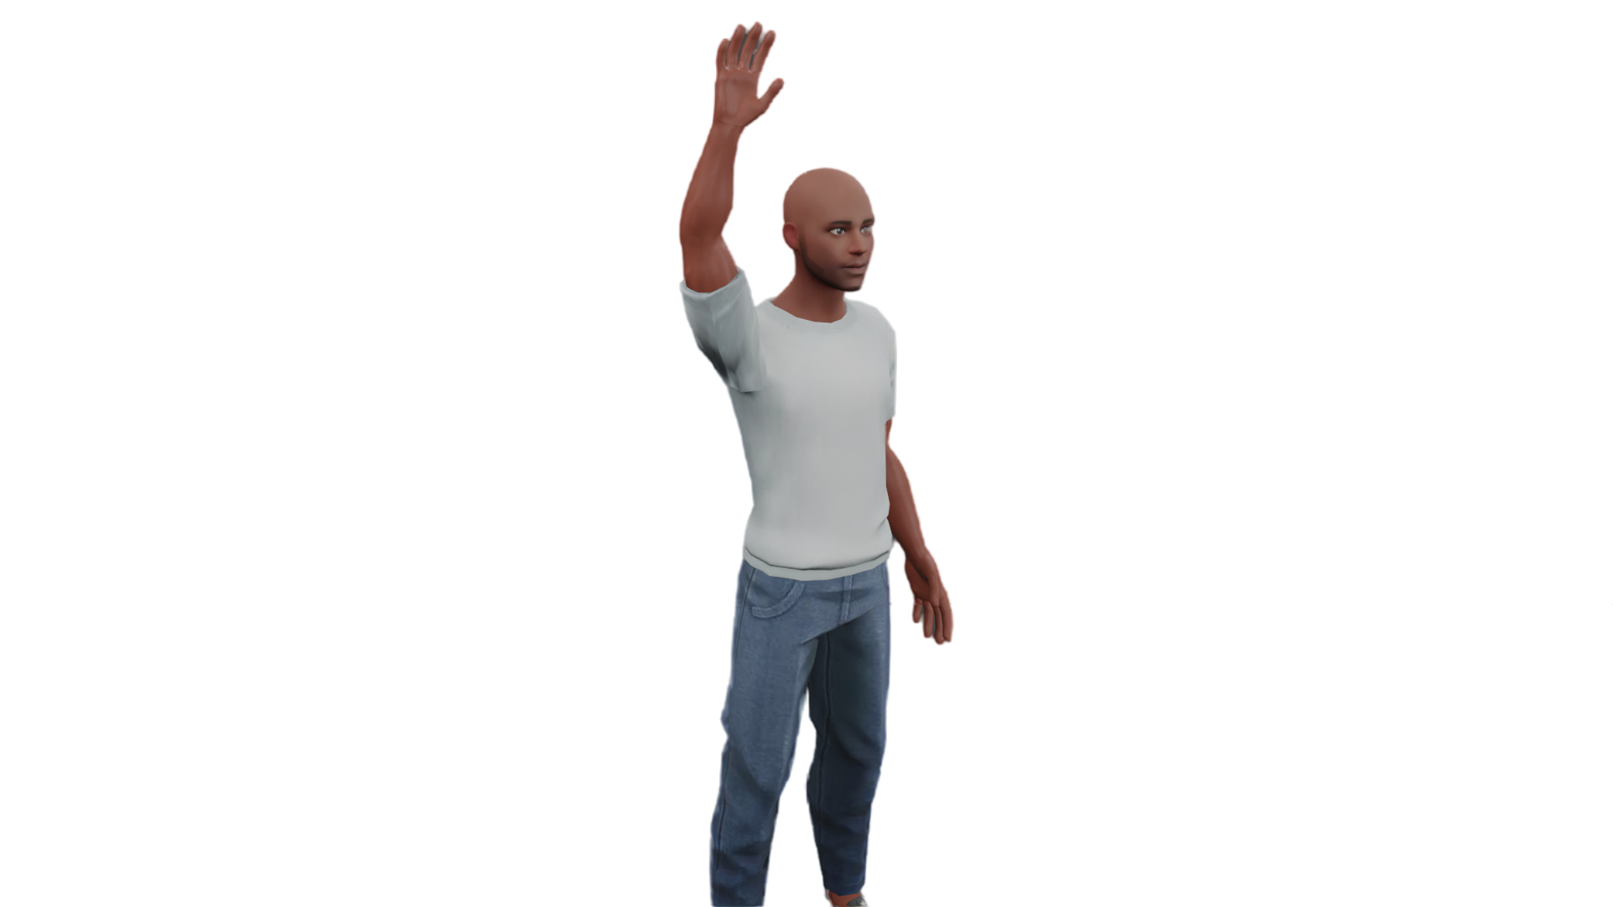
Gesto 4:

Slide 8
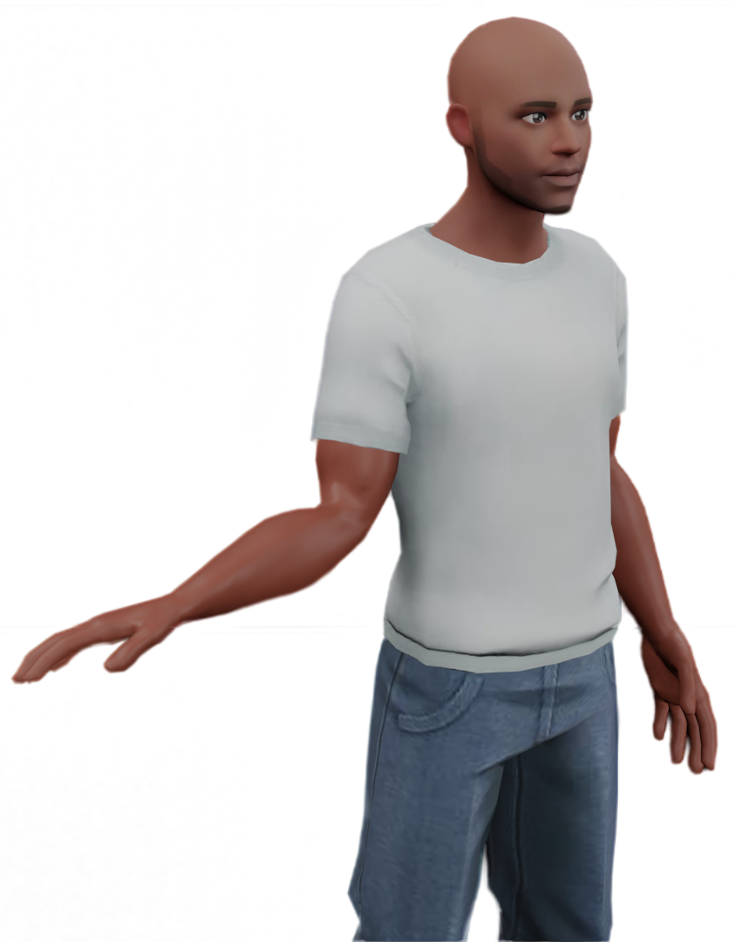
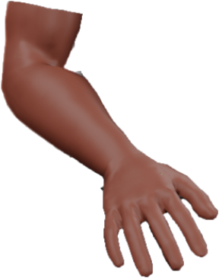
Gesto 5:

Slide 9
a ) Inspect (I) b ) Land (L) c ) Follow me (F) d ) Take-off (T) e) Photography (P)
(g ) Take-Off

Slide 10
a ) Inspect (I) b ) Land (L)
c ) Follow me (F) d ) Take-off (T) e) Photography (P)
(g ) Take-Off

Slide 11
a ) Inspect (I) b ) Land (L) c ) Follow me (F) d ) Take-off (T) e) Photography (P)
a ) Inspect (I) b ) Land (L) c ) Follow me (F) d ) Take-off (T) e) Photography (P)
(g ) Take-Off

Slide 12
a ) Inspect (I) e) Photography (P)
b ) Land (L) c ) Follow me (F) d ) Take-off (T)
(g ) Take-Off

